Slide 1
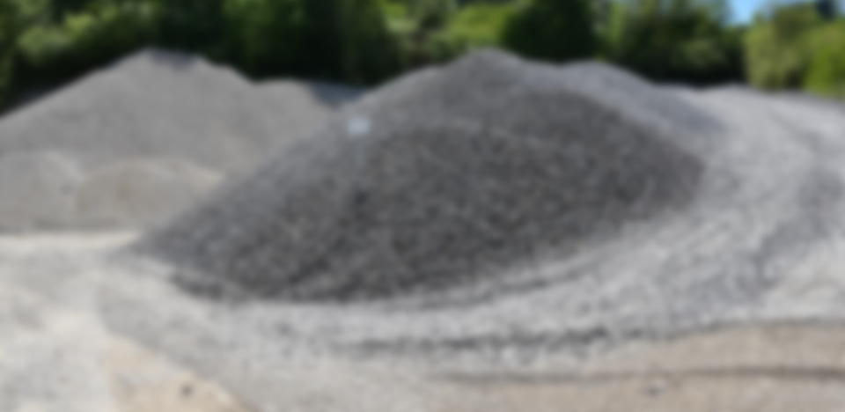
Environment Committee
European and national Mineral Strategies -
a comparison

Slide 2
The European Aggregates Industry
Aggregates Europe - UEPG represents the European Aggregates Industry
by far the largest non-energy extractive industry
Antonis Antoniou Latouros
President
Aggregates Europe - UEPG

Slide 3
European Critical Raw Materials Act
On 18 March 2024, the Council has adopted the Critical Raw Materials Act (CRMA) establishing a framework to ensure a secure and sustainable supply of critical raw materials. Essential raw materials, such as aggregates, are not considered by the CRMA.
The CRMA introduces clear deadlines for permit procedures for EU extracting projects, allows the Commission and member states to recognise a project as strategic, requires supply-chain risk assessments, requires member states to have national exploration plans and ensures the EU’s access to 34 critical and 17 strategic raw materials through ambitious benchmarks on extraction, processing, recycling and diversification of import sources.
The CRMA establishes three benchmarks for the EU’s annual consumption of raw materials: 10% from local extraction; 40% to be processed in the EU and 25% to come from recycled materials. To facilitate the development of strategic projects, member states will have to create single points of contact at the relevant administrative level and at the relevant stage in the critical raw materials value chain.
Extraction projects will receive their permits within a maximum period of 27 months, while recycling and processing projects should receive their permits within 15 months, with limited exceptions aimed at ensuring a meaningful engagement with the local communities affected by the projects and a proper environmental impact assessment in complex cases.

Slide 4
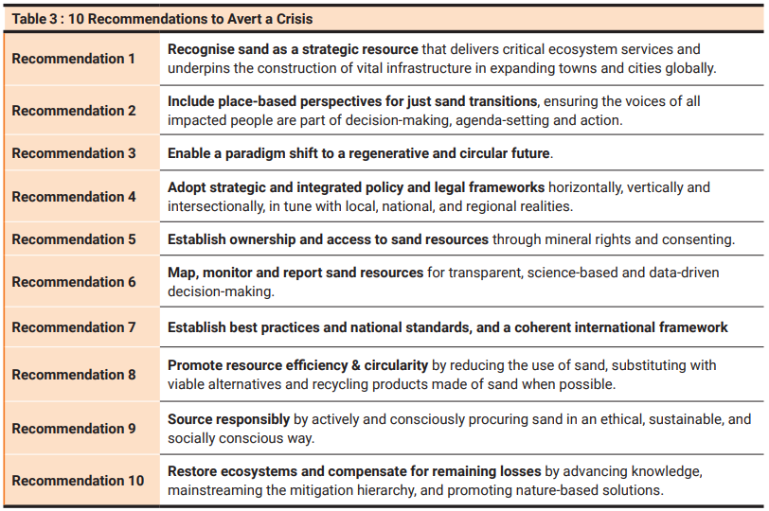
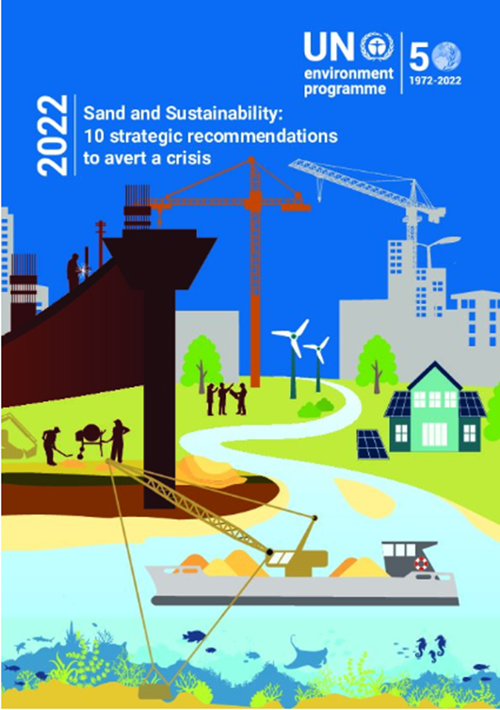
UNEP REPORT ON SAND & SUSTAINABILITY

Slide 5
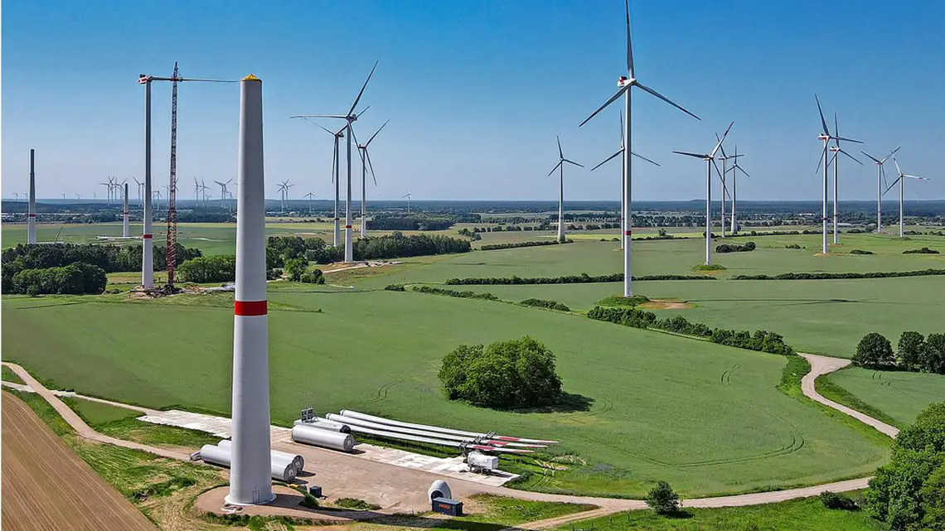
European Critical Raw Materials Act
Why essential raw materials? An example:
“Manufacturing wind turbines and components requires stable, secure supply and cost-competitive supply of raw materials such as concrete, iron, and steel that make up more than 90% of the mass of a turbine, including the foundation.” Wind Europe, Nov 2022
Our colleagues from the German Aggregates Federation (MIRO) stated in the German Parliament during a hearing last week:
One 3-megawatt wind turbine requires 1,300 t aggregates for the base plus 700 t for the tower;
The German Government plans to build 30 wind turbines per week to achieve the “Energiewende”, i.e. 1,560 wind turbines per year;
That means more than 3,000,000 t of aggregates per year for the wind turbines only (not counting for infrastructure), or the total annual average production of an additional 20-30 aggregates sites, not yet permitted.
And we need access now!

Slide 6
Access to Raw Materials
Barriers, Challenges and drivers
The extractive industry’s capital-intensive investments, long start-up times, or complex commodity market developments require stable legal framework conditions and efficient public administration. Permitting procedures for licensing of mineral raw materials exploration and extraction are of significant importance for the sector.
Challenges the permitting systems of EU Member States are confronted with
Involving different authorities: the permit procedure involves many authorities; in many permitting procedure segments, especially at the local / regional level, qualified personnel may be missing or be insufficiently trained;
Long time frames: start of authorisation to permit times are characterised by long or unknown time frames for the permit application;
Multiple and/or conflicting legal provisions: the whole permitting chain sometimes does not have a clear course, since various and sometimes repetitive requirements are requested based on different regulatory policy instruments; and
Non-transparent or unavailable information: available information and support to applicants or investors (i.e. nature and time frame of the process, as well as the level of permitting fees, royalties, etc.) is not sufficient at the time of permit application.

Slide 7
Access to Raw Materials
Permitting Regimes
Permitting procedures for the non-energy extractive industries in EU MS revolve around a principal national or regional authority and other collaborating authorities at all levels that issue an exploration or an extraction permit. Three different permitting regimes: centralised, decentralised or mixed. Centralised regimes are those where permitting procedures are managed by national level authorities, whereas in decentralised regimes, permits are granted by regional (provincial) or municipal authorities.
One-stop shops
As a solution to more complex permitting regimes, a “one-stop” shop per region or country can act as a “single point of contact’ for a potential investor. Such a regime facilitates the coordination and parallel work of co-authorities, reducing the time for decisions to be made and facilitates potential investor´s perspectives on how to deal with all necessary legislation and permits. Some EU MS, such as Austria, Denmark, Germany, Hungary, Ireland, and Portugal have already introduced such a system which has led to lower timeframes for permitting.
Permitting time frames
As regards the time for acquiring an extraction permit, there is a vast variation among different EU MS: Some EU MS share relatively short time frames, ranging from 2 months in Slovakia, to others that cover longer time frames, such as France (e.g. 10 to 16 months for quarried substances) or Spain (3 to 7 years, this number includes the EIA procedure).

Slide 8
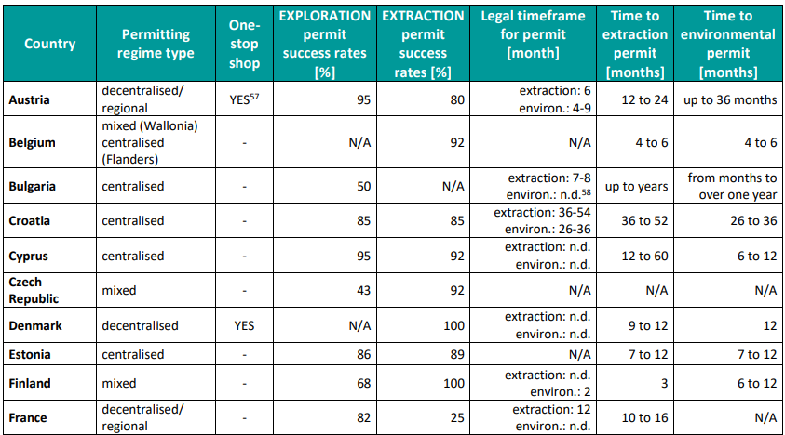
Access to Raw Materials

Slide 9
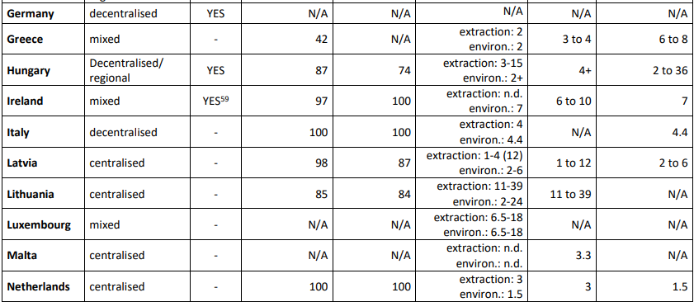
Access to Raw Materials

Slide 10
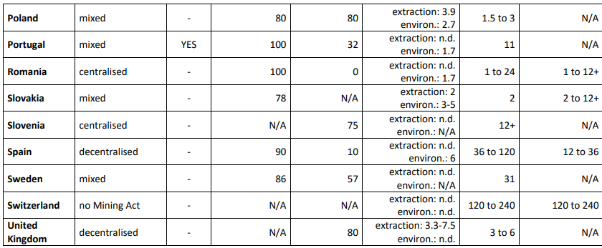
Access to Raw Materials

Slide 11
Access to Raw Materials
Good practice examples
Ireland
One-stop-shop and greater transparency for licensing system for exploration due to publicly available exploration data.
Belgium (Flanders)
One-stop-shop by integrating geological information and mineral safeguarding in land use planning.
Denmark
Parallel process: Environmental impact assessment, remediation plans and payment guarantees are done during the permitting process.
Norway (proposed)
Parallel process: Zone planning and extraction concession are done during the extraction and emission permit procedure.

Slide 12
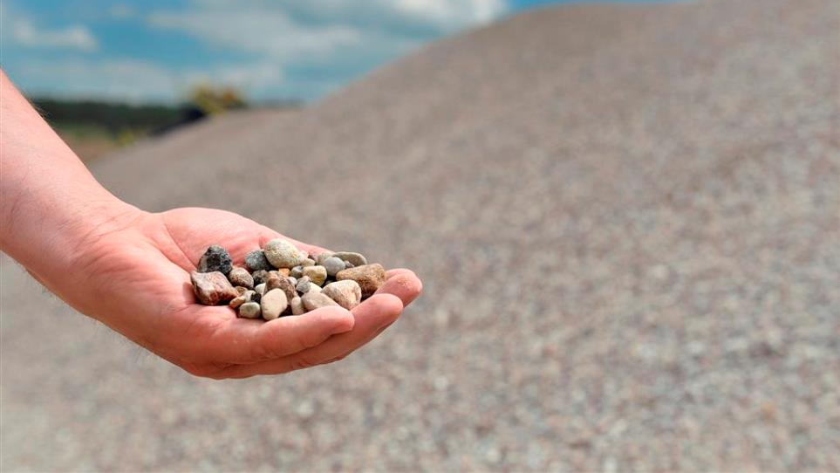
Your voice in Europe!
Aggregates Europe - UEPG
Square de Meeûs 40, 1000 Brussels
secretariat@aggregates-europe.eu
EU Transparency Register: 15340821653-49
www.aggregates-europe.eu
Aggregates Europe - UEPG
UEPG_Aggregates
uepg_agg
Aggregates Europe - UEPG

